Slide 1
Understanding The Technology Value Stream
Austin Moore CSD380 - DevOps 8/18/2024

Slide 2
Introduction
Definition:
The Technology Value Stream represents an end-to-end process of delivery technology solutions. This process functions as an initial idea generated, then goes through a development and deployment phase, then on to a end user delivery.
Purpose:
It helps organizations streamline processes, improve efficiency, and enhance the delivery of any technology solutions.

Slide 3
Lead Time vs. Processing Time
Lead Time:
The time is takes from an initiation of a process to it’s completion. This will include all stages from concept to delivery.
The clock starts when a task or request is made and stops once the task or request is completed.
Processing Time:
The time it takes to actually work on a specific task or phase within the overall process.
This is sometimes referenced as touch time or task time.

Slide 4
The Common Scenario: Deployment Lead Times Requiring Months
Many organizations experience deployment lead times stretching over several months due to inefficient processes, lengthy approval cycles, and complex integration issues. This is very common in large organizations that are limited in having test environments available. Once integration of code needs implemented between multiple teams, this is where bottlenecks occur and create re-work of each section of code to fix the overall problems, hence lead time being so long.

Slide 5
Our DevOps Idea: Deployment of Lead Times of Minutes
Ideal Scenario:
The goal in a DevOps environment is to achieve deployment lead times of minutes. This involves optimizing processes, automating workflows, and fostering a culture of continuous improvement.
It’s done by continuously checking small code changes into version controls to ensure the testing and acceptance environment of those changes.

Slide 6
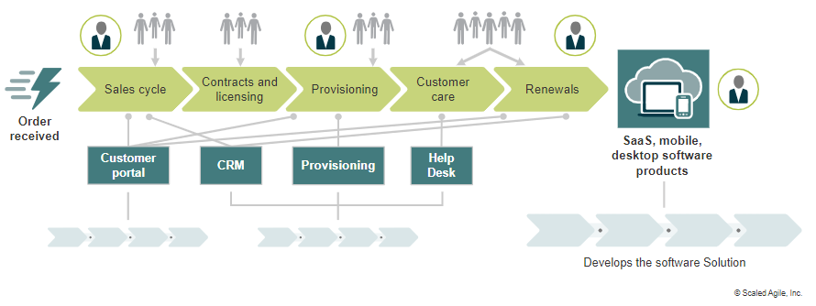
The Value of Stream Mapping Process
Building a stream map that is efficient can help ensure you don’t run into as many bottlenecks during a process.
Identify the Value Stream: Determine the steps from start to finish.
Map the Current State: Document the existing process and workflow.
Identify Areas for Improvement: Look for inefficiencies and bottlenecks.
Design the Future State: Develop an improved process map.
See an example below made by Scaled Agile Inc. that shows how to develop and support a substantial software application through a Value Stream Map.

Slide 7
Benefits of Value Stream Mapping
Efficiency
Reduces waste and streamlines processes
Visibility
Provides a clear view of workflows and dependencies
Customer Value
Enhances the ability to deliver technology solutions that meet customer needs effectively

Slide 8
Resources
Kim, G., Humble, J., Debois, P., Willis, J., & Forsgren, N. (2021). The devops handbook: How to create world-class agility, reliability, & security in technology organizations (Second ed.). IT Revolution Press.
Panchak, P. (2022, August 18). Jim womack explains the origins — and value — of value-stream mapping - lean enterprise institute. Lean Enterprise Institute. Retrieved August 18, 2024, from https://www.lean.org/the-lean-post/articles/jim-womack-explains-the-origins-and-value-of-value-stream-mapping/
Scaled Agile Inc. (2023). Development value streams - scaled agile framework. Scaled Agile Framework. Retrieved August 18, 2024, from https://scaledagileframework.com/development-value-streams/
Vignaud, J.-L. (2022, November 28). How value stream management is fueling digital transformation: Real-world examples. CIO. Retrieved August 18, 2024, from https://www.cio.com/article/413205/how-value-stream-management-is-fueling-digital-transformation-real-world-examples.html

